Slide 1



Career in Stock Market
Get Certified by NISM / SEBI’s Certification
www.isfm.co.in
Special for B.Com & M.Com Students

Slide 2


Content
About Us
Why to Save Money
Understand Stock Market
Power of Compounding in Life
Why to Make Career in BFSI
NISM – SEBI Certification
How to Complaint Against Fraud

Slide 3
About Us
ISFM is one of the most trusted center for Professional stock market learning in Gurgaon.
Institute provides customize stock trading courses relevant to the current needs of the Investors, Traders
Trained more than 400 Investors and Traders in Stock Market
Conducts Central Government approved Investment Awareness Programs Pan India Level
Mission
Goal
Increase awareness among Indians on available Financial Instruments and help them to grow their wealth
Provide professional training on Securities Market to at least 50000 people by 2022

Slide 4


Back To School

Slide 5
Our USP
Provide learning through real-life trading experience
Faculty from premium institutions (IIMs) with live experience
Provide live trading experience through demo platform
Strong emphasis on risk management
Building a community of knowledgeable traders

Slide 6


Why People Save Money

Slide 7







Home
Your or your Child’s Marriage
Vehicle
Your Life Goals could be…
World Tours
Children’s Education
Investments
Comfortable Retirement
Notes:
Detailed Explanation On - FD v/s Equity Example
Conclusion – What you could have bought last year with Rs 100 you cant buy today with 107.2 since your money in real terms depreciated

Slide 8
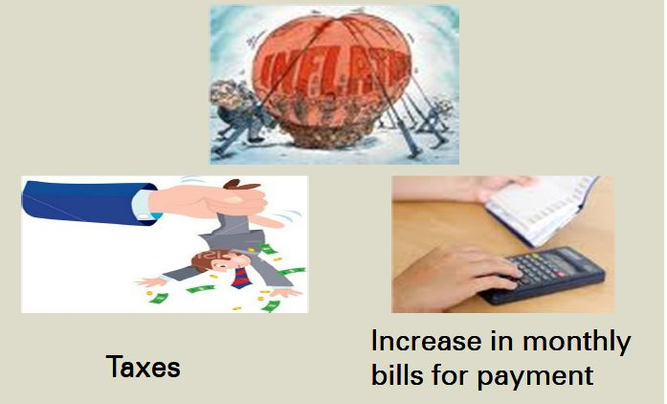
Is just saving is Enough

Slide 9
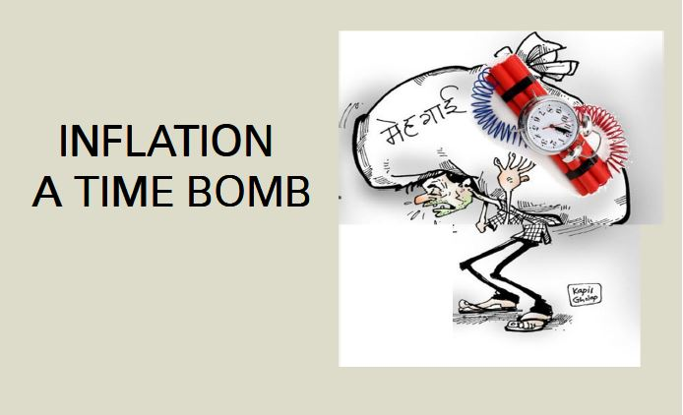
Is your investment can beat the inflation

Slide 10


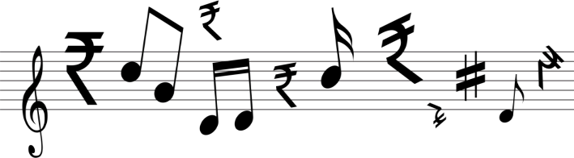

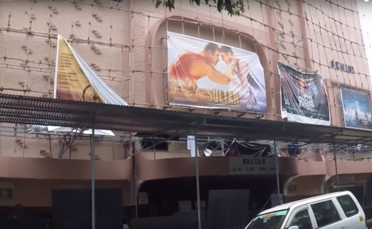






Inflation is Eroding your Money
Rs. 500
Rs. 50
Rs. 50,000
Rs. 50,000
500 %
400 %
900 %
900 %
Rs. 3000
Rs. 250
Rs. 5,00,000
Rs. 5,00,000

Slide 11
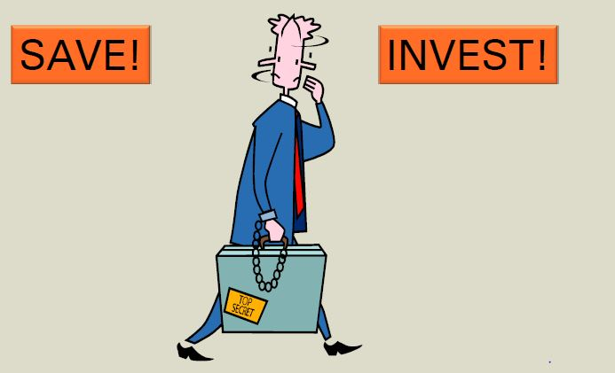
India people are confused what to do ?

Slide 12
Risk
Risk taking ability
Income / Expenditure
Life cycle
Assets
Liabilities
Notes:
An important part of preparation of a financial plan is assessment of risk taking ability.
Understand the risk taking ability
Income & Expenditure and Assets & Liabilities play a very important role in an individual’s risk taking ability
High income does not necessarily mean high risk appetite if the person also has large amount of liabilities
Low income used judiciously to build assets, can increase risk appetite
For two college going students will the risk taking ability be same if one’s father is the richest businessman in town and the other’s father has expired 5 years back and their family is dependent on the investments made by his father.
Ask students to come out with reasons why each student’s risk taking ability will be different
12

Slide 13
Three types of level Risk
Conservative ( Never take Risk in their life )
Moderate ( Medium risk taker people )
Aggressive ( High risk taking people )

Slide 14
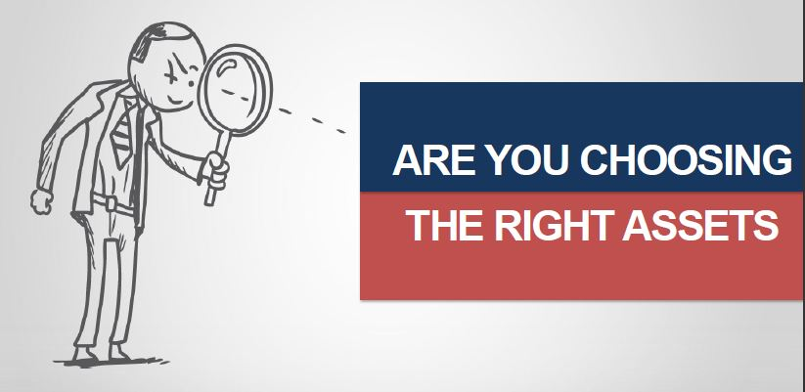
Where People Investing Money

Slide 15
Common Products
Name of Product | Expected / Nominal Return | Method | Competent to Inflation (10%)
Saving Bank A/c | 4 % | Traditional | Not
Gold | 20 % | Physical | Yes
Insurance | 6 % | Traditional | Not
Real Estate | 15-20 % (unexpected) | Traditional | Yes
Post office Scheme | 6-8 % | Traditional | Not
New Pension System | 12-13 % | Modern | yes

Slide 16
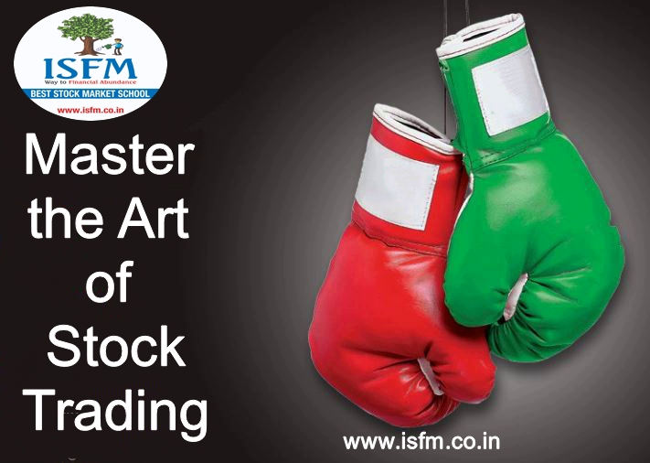
Basic of Securities Market

Slide 17
What is Stock Market
It is a place where shares of pubic listed companies are traded.
The stock market refers to the collection of markets and exchange where the issuing and trading of equities (stocks of publicly held companies), bonds and other sorts of securities takes place, either through formal exchanges or over-the-counter markets.
Also known as the equity market, the stock market is one of the most vital components of a free-market economy, as it provides companies with access to capital in exchange for giving investors a slice of ownership.

Slide 18
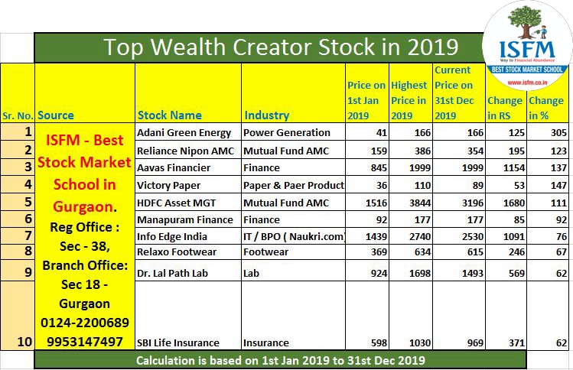

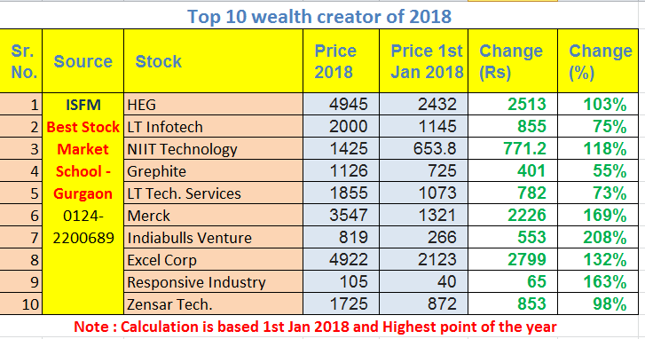
Top Wealth Creator Stocks 2018

Slide 19

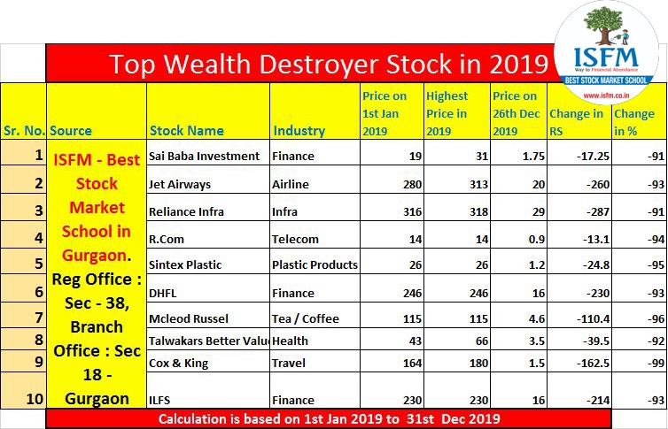
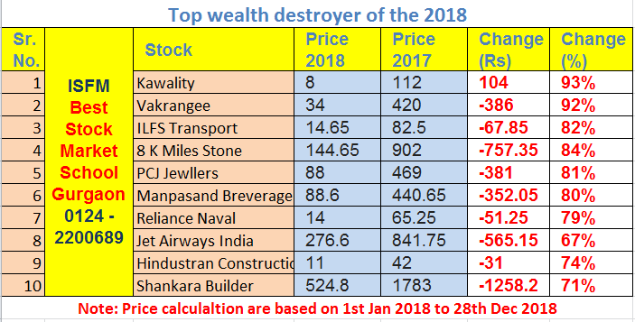
Top Wealth Destroyer Stocks 2018

Slide 20
Why to Invest in Stock Market
Stock Market investments offer you benefits like
Liquidity
Flexibility of amounts invested
Operated under high level of regulatory framework to safeguard investor rights
Technology based Investment
High return
Capital growth
Dividend

Slide 21
Top Mistakes for investment
Trade without learning
Trade with small capital with big margin
Don’t use the stop loss level
Fail to calculate risk and reward ratio
Missing of analysis knowledge
Not able to control greed and emotions
Dealing with unauthorized intermediaries

Slide 22
Financial Markets
Financial System
Financial Markets
Financial Instruments
Financial Participants
Financial Regulator
Financial Services
Capital Markets
Money Markets
Forex Markets
Commodity Markets
Primary Markets
Secondary Markets
Treasury Bills
Certificate of Deposits
Commercial Paper
Call Money
Equity
Debt

Slide 23
Hierarchy of Stock Market
Securities & Exchange Board of India (SEBI)
National Securities Depository ltd
(NSDL)
Central Depository Services ltd
(CDSL)
National Stock Exchange of India (NSE)
Bombay Stock Exchange of India
(BSE)
Stock Brokers
&
Sub Brokers
Investors

Slide 24
Financial Regulators
Securities Market
Banking
Insurance
Pension
Commodities derivatives
FINANCIAL MARKET

Slide 25
What is Stock Exchange
The stock exchanges in India, under the overall supervision of the regulatory authority, the Securities and Exchange Board of India (SEBI), provide a trading platform, where buyers and sellers can meet to transact in securities. The trading platform provided by NSE is an electronic one and there is no need for buyers and sellers to meet at a physical location to trade. They can trade through the computerized trading screens available with the NSE trading members or the internet based trading facility provided by the trading members of NSE.
What is Demutualisation of stock exchanges?
Demutualisation refers to the legal structure of an exchange whereby the ownership, the management and the trading rights at the exchange are segregated from one another.
How is a demutualised exchange different from a mutual
exchange?
In a mutual exchange, the three functions of ownership, management and trading are concentrated into a single Group. Here, the broker members of the exchange are both the owners and the traders on the exchange and they further manage the exchange as well. This at times can lead to conflicts of interest in decision making. A demutualised exchange, on the other hand, has all these three functions clearly segregated, i.e. the ownership, management and trading are in separate hands.

Slide 26
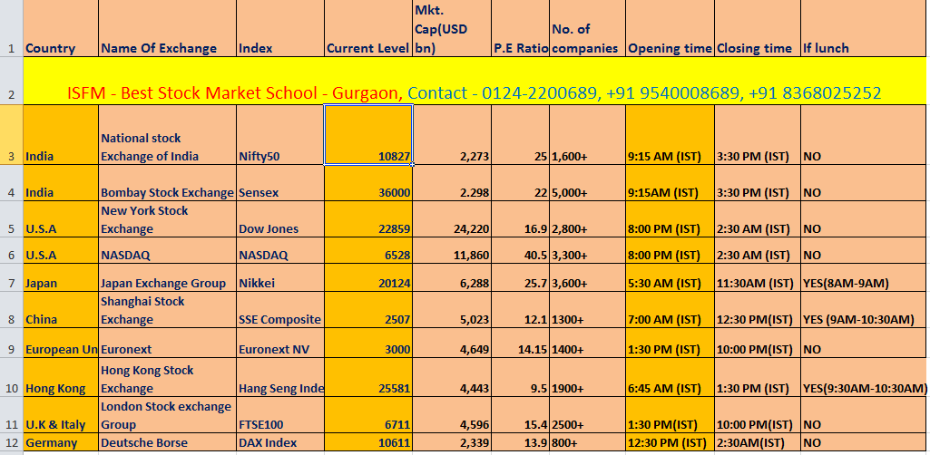
Major Stock Exchange in the World

Slide 27

Equity market
Current level : 12248
No. of listed co : 1450
Timing : 9:00 am to 3.30 pm
Duration : Monday to Friday
PE Ratio : 22.66 (24/01/2020)
Market cap : 88 T
52 week H / L : 12430: 10583
Website : www.nseindia.com

Slide 28
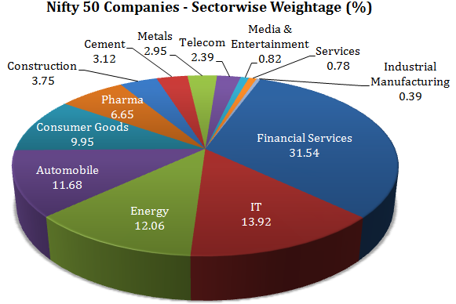
Nifty - 50

Slide 29

Equity market
Current level : 41613
No. of listed co : 4400
Timing : 9:00 am to 3.30 pm
Duration : Monday to Friday
PE Ratio : 28 (17/11/2019)
Market cap : 72 T
52 Week H/L : 42273 / 35287
Website : www.bseindia.com

Slide 30
How to open a Demat account
Basic Requirements
PAN
Fill the Application Form ( Check Power of Attorney)
Demat Account opened (BSDA an option)
Aadhar Card / Proof of identity and address
Photo
DP- Client Agreement duly signed in 100 rupees stamp paper
Copy of report – client details captured in the system
Deliver Instruction Slip Book
(like cheque book)
Unique ID ( 8/16 digit )
Bank Account

Slide 31
Primary Market
Products :
• INTIAL PUBLIC OFFER – IPO
• FOLLOWING PUBLIC OFFER– FPO
• RIGHTS ISSUE
• PRIVATE PLACEMENT
• PREFERENTIAL ALLOTMENT
Participants :
Resident Individuals
HUF
Minors through guardians
Registered Societies and Club
NRI
PIO
Qualified Foreigh Investor
Banks
Financial Institutions
Association of Person
Companies
Partnership Firm
Trust
FII
DII
LLP

Slide 32
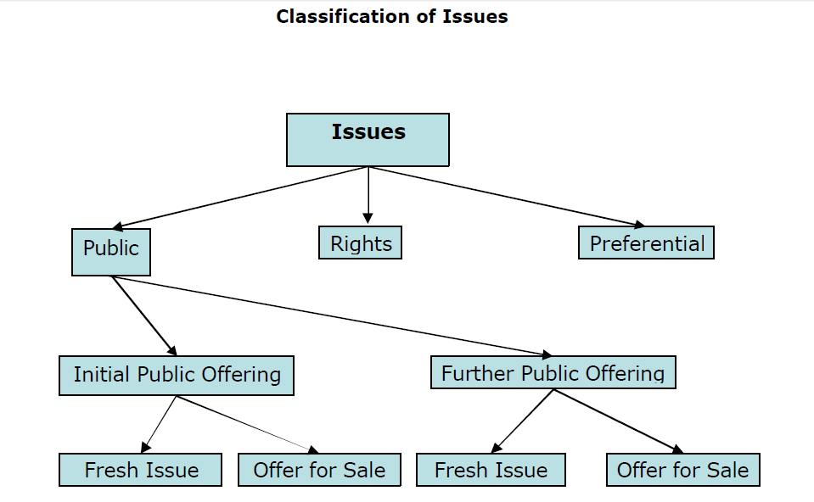

Slide 33

Secondary Market

Slide 34

Classification of Shares

Slide 35
Classification of Securities
Products
Share
Bonds
Debentures
Commercial Papers
Treasury bills
Commodities
Currency
Mutual Funds
CLASSIFICATION OF EQUITY SHARES
• BLUE-CHIP SHARES
GROWTH SHARES
INCOME SHARES
CYCLICAL SHARES
DEFENSIVE SHARES
SPECULATIVE SHARES

Slide 36

Stock Trading
A Battle field to
Understand

Slide 37
Types of the Trading
Intraday Trading :
When we buy / Sell the share between 09:15 am to 03:30 pm called the intraday trading.
Delivery Base Trading :
When we buy the share and hold for one day or more than one day called delivery base trading.

Slide 38
Difference
Intra Day Trading
Delivery Base Trading
You have to square off on the same day
Low transaction charges
High Exposure for Trading
High risk due to less time
Low tax applicable
You are not owner of the securities
Not mandatory
Transaction charges is high
Less Exposure for Trading
Low risk
High tax applicable : STT
You are owner of the securities

Slide 39


Slide 40


Slide 41
RS. 1CR. V/S RE. 1
Sun | Mon | Tue | Wed | Thu | Fri | Sat
 | 1 | 2 | 3 | 4 | 5 | 6
7 | 8 | 9 | 10 | 11 | 12 | 13
14 | 15 | 16 | 17 | 18 | 19 | 20
21 | 22 | 23 | 24 | 25 | 26 | 27
28 | 29 | 30 |  | Total: 30 Crores

Slide 42
RS. 1CR. V/S RE. 1
Sun | Mon | Tue | Wed | Thu | Fri | Sat
 | 1 Rs. 1 | 2 Rs. 2 | 3 Rs. 4 | 4 Rs. 8 | 5 Rs. 16 | 6 Rs. 32
7 | 8 | 9 | 10 | 11 | 12 | 13
14 | 15 | 16 | 17 | 18 | 19 | 20
21 | 22 | 23 | 24 | 25 | 26 | 27
28 | 29 | 30

Slide 43
THE DEAL
Sun | Mon | Tue | Wed | Thu | Fri | Sat
 | 1 | 2 | 4 | 8 | 16 | 32
64 | 128 | 256 | 512 | 1,024 | 2,048 | 4,096
8,192 | 16,384 | 32,768 | 65,536 | 131,072 | 262,144 | 524,288
10,48,576 | 20,97,152 | 41,94,304 | 83,88,608 | 1.67 Crores | 3.35 Crores | 6.71 Crores
13.42 Crores | 26.84 Crores | 53.68 Crores |  | Total = Rs. 1,07,37,41,823 (107 crores – 30 crores)
1
2
3
4
5
6
7
8
9
10
11
12
13
14
15
16
17
18
19
20
21
22
23
24
25
26
27
28
29
30

Slide 44
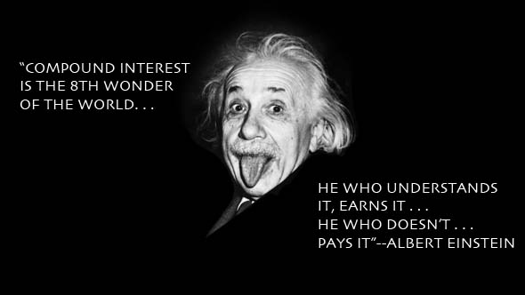

Slide 45


Achieving Financial Goal
Benefit of starting early :
Ram creates more wealth than Sham by investing
lesser amount
Who do you
think will create more wealth for
their retirement
at the Age of 55?
Ram
Sham
Ram starts investing at the age of 25. He Invests Rs.10,000 per month for 30 years in a fund earning 9% rate of return per annum.
Ram Creates Wealth of
Rs. 1.84 Crores
by Investing Rs.36 Lacs
Sham starts investing at the age of 40. He invests Rs.25,000 per month for 15 years in a fund earning 9% rate of return per annum.
Sham Creates Wealth of
Rs. 95 Lacs
by Investing Rs. 45 Lacs
Ram and sham both aged 25 years want to retire at the age of 55 ,
for which they want to make investment for happy retired life.
Longer the term, higher the compounding effect

Slide 46
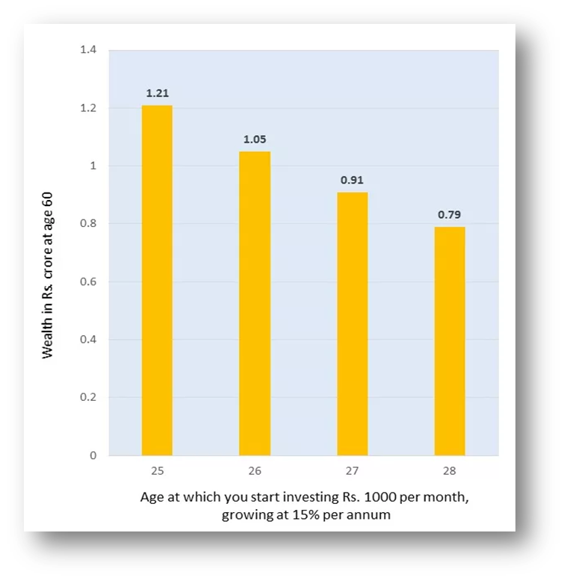
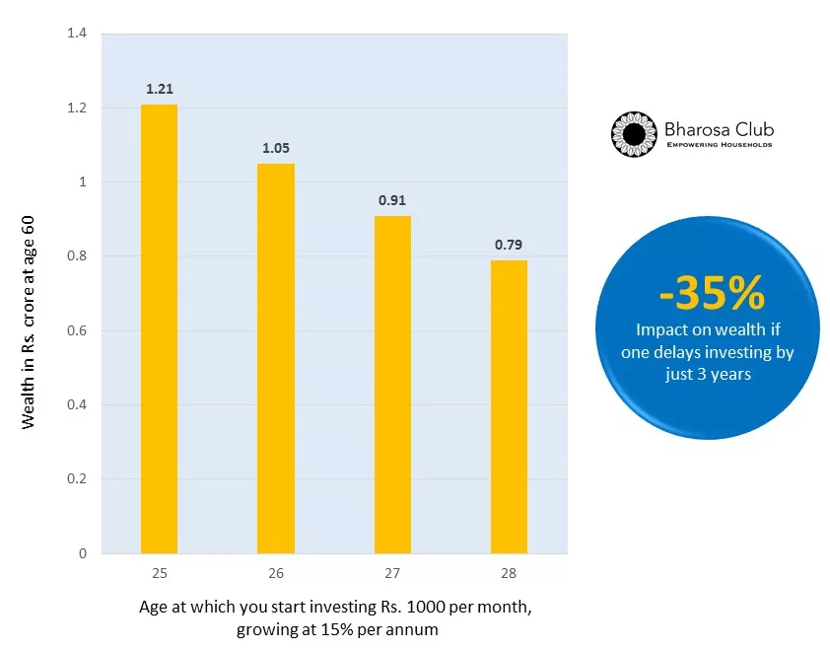
Start investing today!
1.21 Cr
1.05 Cr.
0.91 Cr.
0.79 Cr.
Disclaimer : This calculation is for illustration purpose only. The return shown are XIRR returns. Mutual Fund investments are subject to market risks, read all scheme related documents carefully.
Notes:
Suggest Animation

Slide 47

I made my first investment at the age of 11
I was LATE!
Warren Buffet (Net worth of $65 billion)

Slide 48
Career in Stock Market
Get Certified by NISM / SEBI’s Certification
Special for MBA & BBA Students

Slide 49
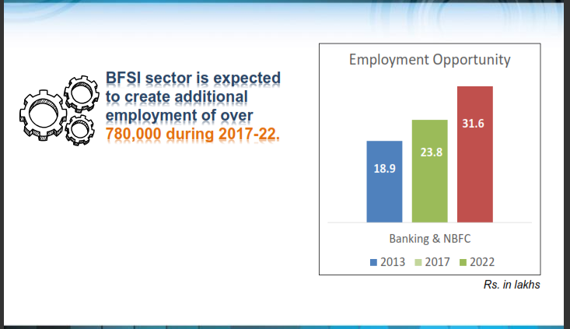
Why to Make Career in BFSI
www.isfm.co.in

Slide 50
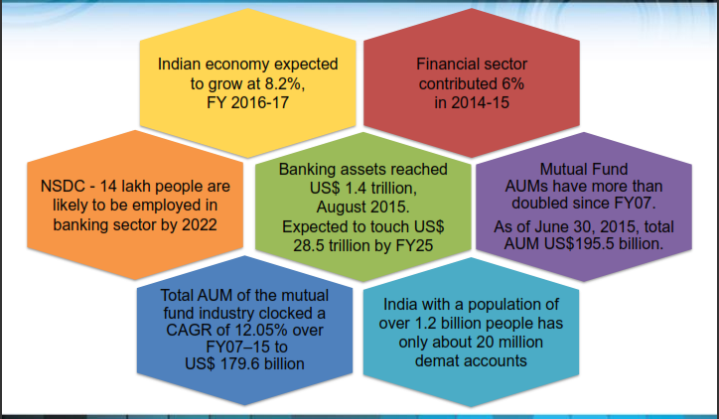
Facts about BFSI Market

Slide 51
Facts about BFSI Market
The sector employs around 4.5 Mio people and is growing at a healthy 15% and is estimated to be around USD30Bn
Largest segments are Banking and Intermediaries. Estimated current employment in the above segments is provided in the table below:
Industry segments Total employment (In ‘000s) % of total Projected 2022 Incremental
Banking* 1100 – 1200 25 – 30% 1400-1500 350
Insurance* 200 – 300 4 – 5% 350-400 150
NBFC* 25 – 30 0 – 1% 40-45 10
Mutual Funds* 15 – 20 0 – 1% 20-25 15
Financial Inter 2500 – 3000 65 – 70% 6000-7500 3700
Total 4000 – 4500 100% 8000-9000 4225
Source: RBI, IRDA, Capital line, IMaCS analysis; *On-rolls employee
4.2 Mio incremental employment to be generated by BFSI sector by 2022 with Banking and Intermediaries driving the demand

Slide 52
Industry Speaks
Wealth Managers are one of the Highest Paid Employee of the Banks.
[Source – Naukri.com
Banking, Insurance & Financial Services – one of the hottest career options and also one of the best paid and sought after.
[Source – India Today]
“There are approx. 600 wealth managers in all of India. Over the next five years, the increase will be 15-20 times.”
[Source – Mr. K. Ram Kumar. Ex HR Head ICICI Bank]

Slide 53
Designation, Roles & Responsibilities
Job Profile : Analyst, Financial Advisory, Relationship Management, Investment Advisory , Insurance Advisory, Mutual Fund
Sl. no. | Designation | Employers
1 | Relationship Manager | Banks, Brokerage Firms, Fund Houses
2 | Investment Advisor, Wealth Manager, Financial Advisor, Financial Planner | Private Banking, Wealth Management firms, Financial Planning Outfits, Fund Houses
3 | Insurance Advisors | Insurance Companies
4 | Faculty/Content Writer/Trainer | Educational Institutes / Corporate
5 | Independent Financial Planner | Self Employed
6 | Mutual Fund Business / Agent | Free lancer, Self Employed

Slide 54
Career Path
Cluster Head/Zonal Head/ Regional Head/AVP/VP
Sr Executive/Manager / Team Leader/ Unit Head/ Branch Head
Executive /Asst Mgr
Business Head, Channel Head/VP/SVP
CEO/ED/EVP
Broad CTC Range
Broad Experience
Skills Required
Career advancement
50lac+
15-25 + years
Soft Skills
Product skills
Customer Management
Selling skills
Business understanding
Trading skills
Technical Analysis skills
25- 50 lacs
10-15 years
8 - 25 lacs
5-10 years
4- 8 lacs
2-5 years
3-6lacs
0-2 years
Note -All data is indicative and will vary by company

Slide 55

Pay Scale – BFSI Industry
Median salaries (INR) in India based on years of experience
Source: Dated: 22nd Dec, 2016

Slide 56
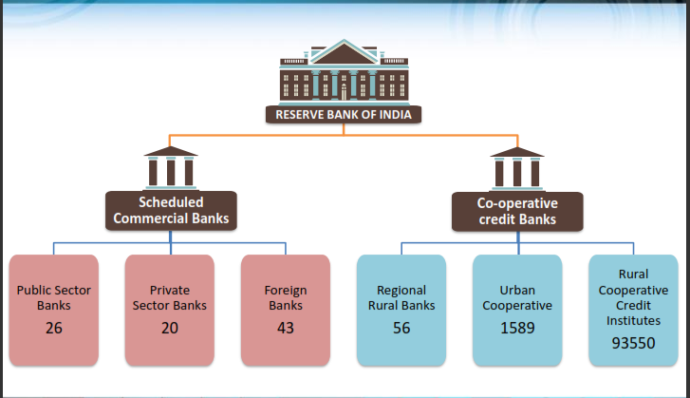
Banking Sector Structure in India

Slide 57
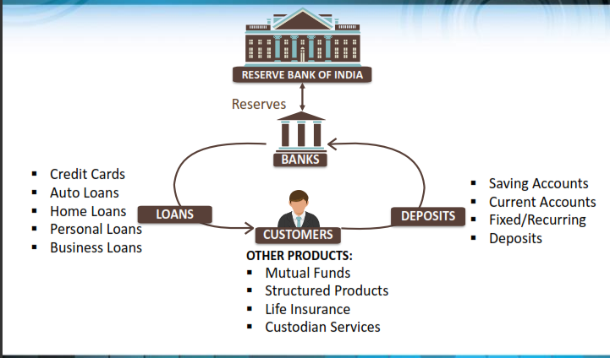
Retail Banking

Slide 58
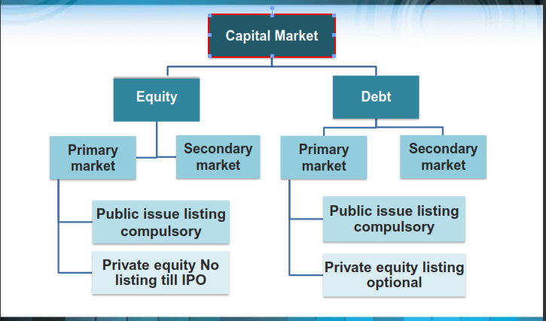
Capital Market Structure

Slide 59
Certifications & Program
CERTIFIED FINANCIAL PLANNER- CFP
CHARTED FINANCIAL ANALYST - CFA
NISM/ SEBI Certifications
ACCA / CA

Slide 60
NISM – SEBI’S Certifications
Diploma in Stock Trading
Technical Analysis Course
Equity Derivatives Certification
Mutual Fund Certification
Focus: Equity, Derivatives, Commodity, Currency, Mutual Fund
Duration: 70-80 hours
Focus: Technical analysis of stocks (Right Entry/ Exit Time)
Duration: 25-30 hours
Focus: Equity. Derivatives - SEBI’s Certification
Duration: 30-32 hours
Focus: Mutual Fund - SEBI’s Certification
Duration: 30-32 hours

Slide 61

How to Enroll for Certifications
ISFM - Class Room Program
Online Job Booster Certification Program
Visit our website www.isfm.co.in and Enroll for live training program.
Walking in our office & get free counseling with expert, also get free live demo class.
Call our counselor for assessment
Visit www.certifications.nism.ac.in & make your profile.
Call to NISM Executive for assistance for details about all certification
Enroll for online exam and get Certificate
0124-2200689, 9540008689

Slide 62
Internship & Live Projects
Internship
Live Projects
ISFM will provide Internship to
students in -
  Broking houses
  Equity Research companies
  Mutual Fund Companies
  Hedge Fund Companies
  Banks
  KPO ( Knowledge Process Outsourcing)
  Arbitrage companies
Location of Internship will be Delhi -
NCR
ISFM will provide Live Projects to
students where they will work on a
Live Problem faced by a company
Some of the Live Project topics could
be:
  Portfolio Management
  Equity Research
  Technical Analysis
  Advanced Derivatives
  ….

Slide 63











Potential Employer

Slide 64


Some Do’s and Don’ts

Slide 65
Do's
Always deal with the SEBI registered brokers.
Collect photocopies of all documents executed for registration as a client, immediately on execution.
Give clear instructions to your broker and insist on contract notes from your broker.
Check credentials of the companies, its management, fundamentals and recent announcements made by them.
Adopt trading / investment strategies commensurate with your risk-bearing capacity
There are no guaranteed returns on investment in the stock market .
Always keep copies of all investment documentation

Slide 66
Don'ts :
Don't deal based on rumours or 'tips' and fall prey to promises of guaranteed returns.
Don't get swayed by promises of high returns.
Don't leave the custody of your Demat Transaction slip book in the hands of any intermediary.
Don't blindly follow media reports on corporate developments, as some of these could be misleading.
Don't forget to take note of the risks involved in an investment.
Don't hesitate to approach appropriate authorities in case of complaint.

Slide 67



Complaints & Grievance Handling at SEBI

Slide 69

SEBI Toll-free helpline service for investors
1 800 22 7575
1 800 266 7575
Notes:
This is a multi-lingual facility covering 14 different languages, viz., English, Hindi, Marathi, Gujarati, Tamil, Bengali, Malayalam, Telugu, Urdu, Oriya, Punjabi, Assamese, Kannada and Kashmiri.
Investors can seek guidance in the matters related to:
Status of companies – whether unlisted, sick, delisted, liquidated / would up, etc.
Changes in names of companies pursuant to amalgamation / merger / demerger, etc.
Details of Registrars and Share Transfer Agents of a listed company
Details and information on the names and addresses of various registered intermediaries
Where to get information on regulatory action taken by SEBI
Where to get information on corporate action like dividend, bonus, rights issue, etc.
Where to get latest NAVs of mutual fund schemes
How to lodge a complaint with SEBI
Against whom to lodge a complaint in SCORES
Status of complaint lodged with SEBI
Names and addresses of various Registrar of Companies, Official liquidators, BIFR, etc.
The regulators / authorities whom the investor has to approach for redressal of their grievances that are not under SEBI purview ex: RBI, IRDA, PFRDA, MCA, etc.
The toll free helpline also provides assistance in matter of:
How to open a demat / client account
Transfer of shares
Transmission of shares
Documents required for transfer / transmission of shares
Information on what to do if shares are lost / forged / fake
Procedure for applying for duplicate shares
How to apply in an IPO
Names and addresses of companies who have filed offer documents with SEBI
Investors must keep in mind that this facility is not to avail legal or investment advice.

Slide 70


On June 8, 2011, Sebi had commenced a new web-based centralised grievance redress system called as SCORES
SEBI’S SCORE PORTAL

Slide 71
SCORE…
Lodge Complaints Online
Track & Monitor the status of the complaint
Receive final outcome of the complaint online

Slide 72
SCORE…
Securities and Exchange Board of India : www.Score.sebi.gov.in
Insurance Regulating and Development Authority of India :
www.igms.irda.gov.in
New Pension System (NPS )
www.cgms.gov.in
www.nsdl.com

Slide 73

THANKYOU
Reg. office :
Plot No-152-P, Sec-38, Medicity Road, Near Bakhtawar Singh Chowk, Gurgaon – 122001, Haryana, India
Contact no. : 0124 – 2200689 +918287630833
Branch Office:
Plot No-20-A, Sec-18, Old Delhi Road, Near Maruti gate no. 1 Gurgaon – 122001, Haryana, India
Contact no. : +919953147497, +918168573253

